Slide 1
MSDA Bootcamp 2026
Kwan To (KT) Wong
Faculty of Social Sciences, HKU

Slide 2
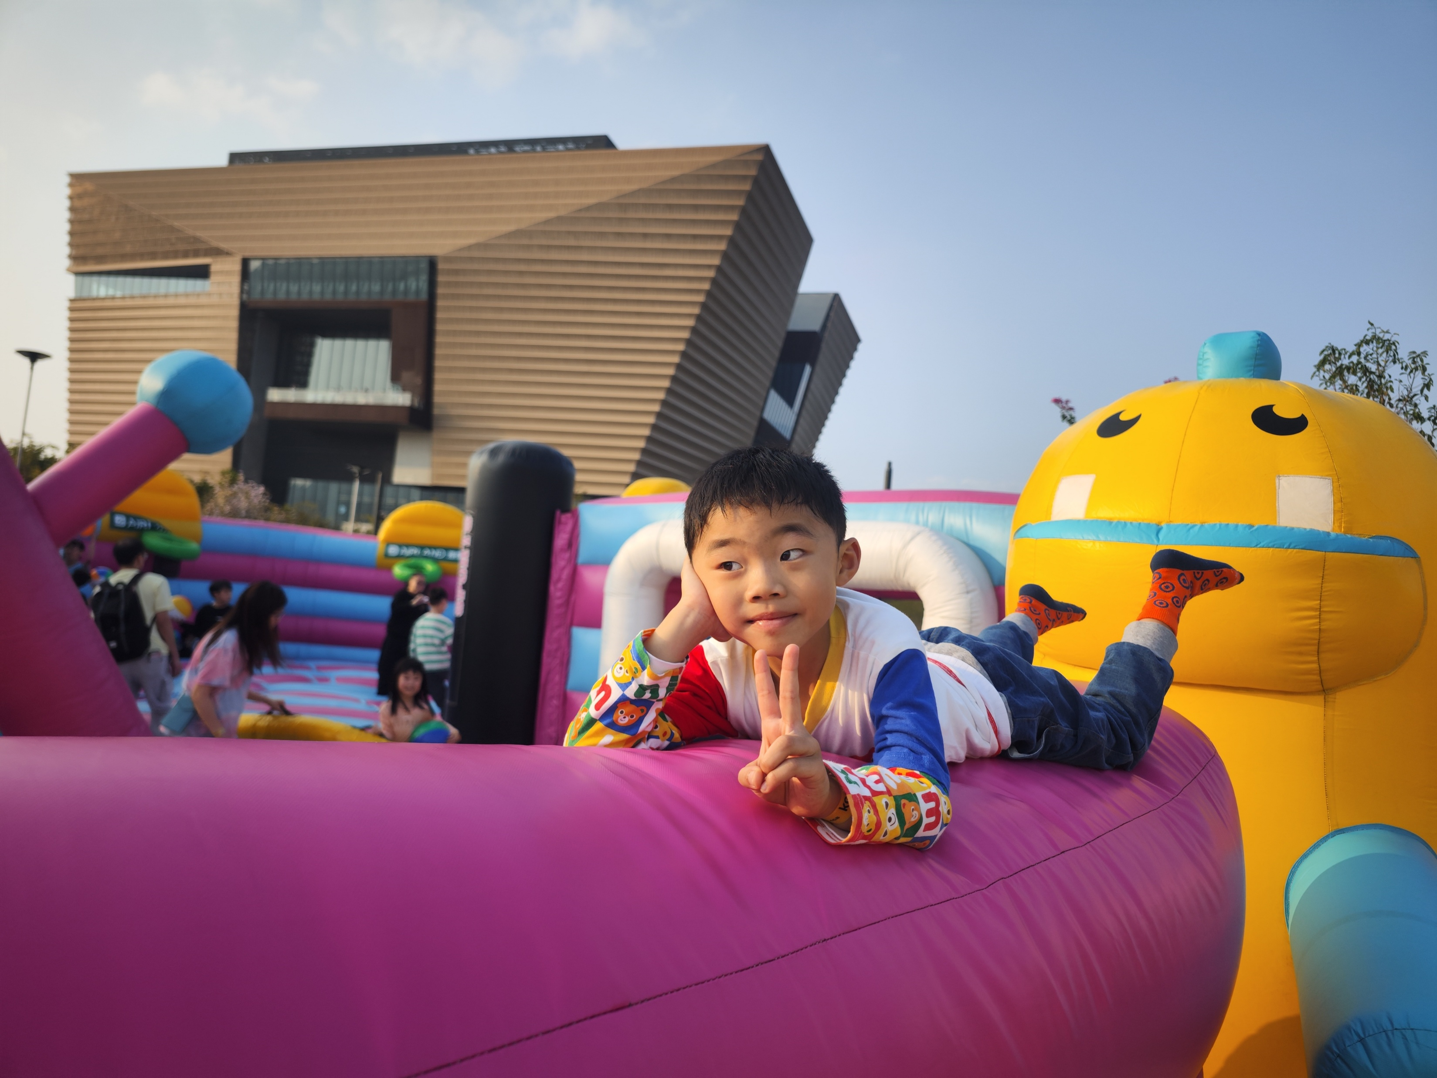
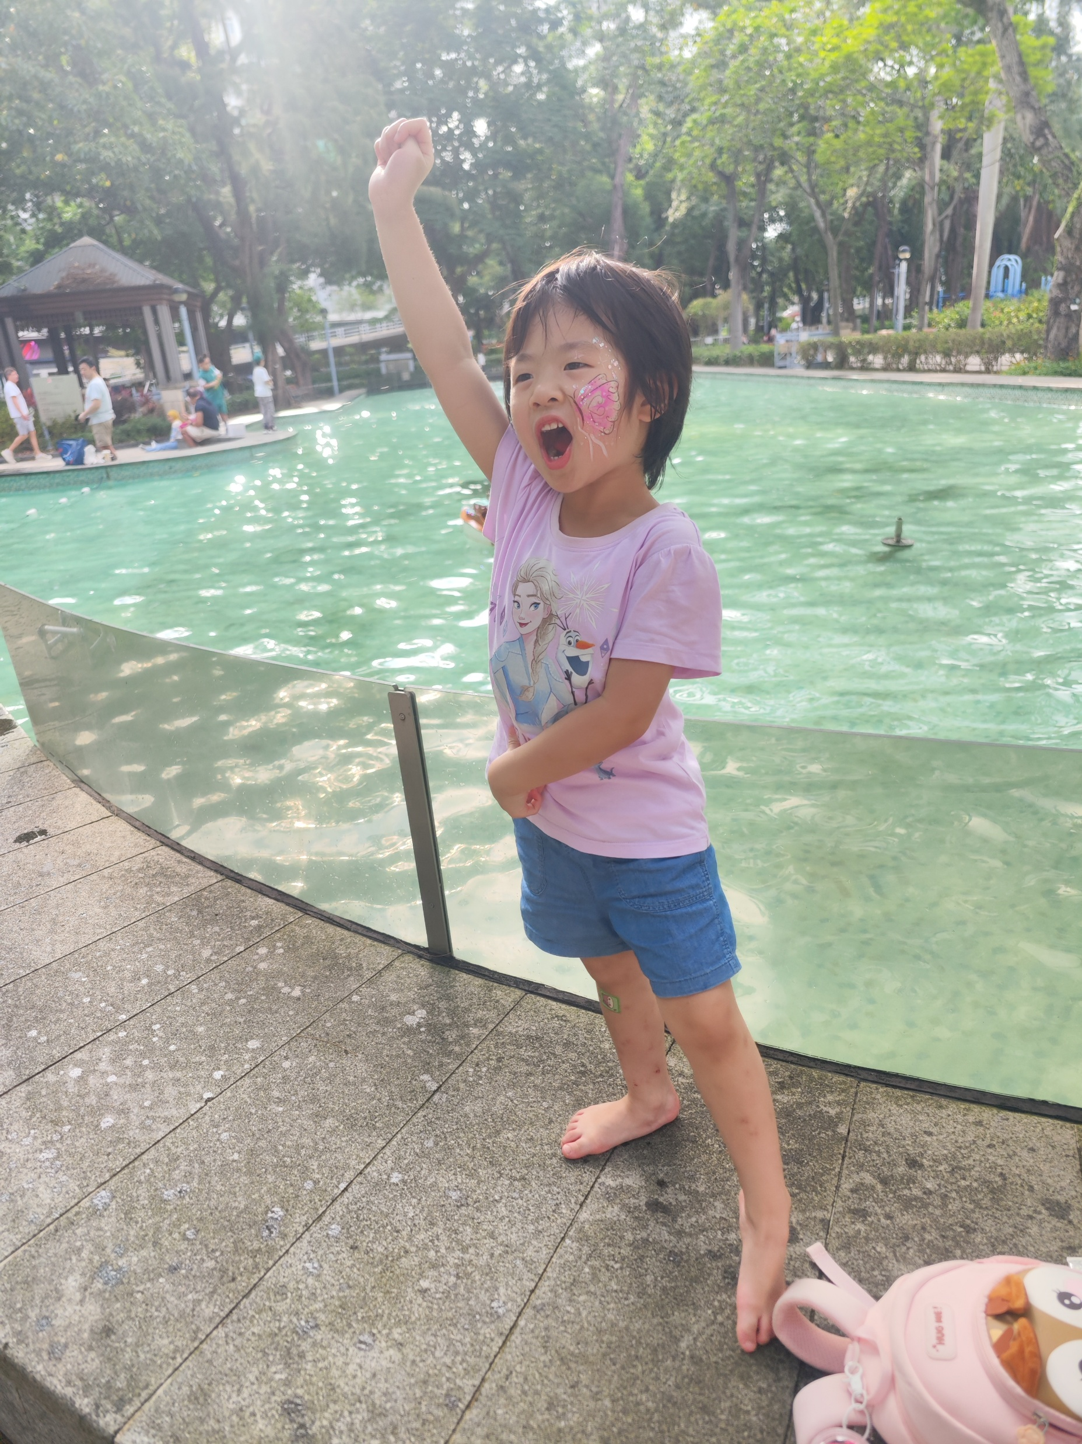
Introduction of myself
My name: Wong, Kwan To (KT)
Hong Kong local guy (born in Shanghai!!)
Received most my education in Hong Kong (HKU, CUHK)
My training is in economics
Work in universities for more than 20 years (HKU, HKUST, PolyU, CityU, …)
Work at Faculty of Social Sciences now
My major contact: kwanto@hku.hk
Meanings of life to me

